Slide 1
education
psychology
…unending youth!
future…
body
sociology
parents
arts
languages
work ethic
with hands
learning
youth
with heart
adolescence
but… children first!
environment
soul
philosophy
schools
sciences
with heads
pedagogy
physiology
teachers
theories, principles
…past
mind
childhood

Slide 2
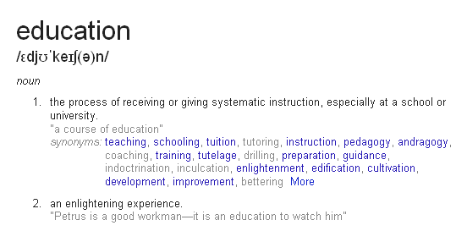

Slide 3
caveats!
some thoughts on education (=life) (and still thinking…)
only some pointers – no proofs!
personal notes based on experiences
“A thought is an arrow shot at the truth; it can hit a point , but not cover the whole target. But the archer is too well satisfied with his success ,to ask anything farther. “
-- Sri Aurobindo

Slide 4
what is education?
J. Krishnamurthi: What NOT is education?
Rudolph Steiner: ‘We shouldn’t ask “What does a person need to be able to do in order to fit into the existing social order today?” Instead we should ask “what lives in each human being and what can be developed in him or her?” ’
Maria Montessori: It is a preparation for Life.
Mohandas Karamchand Gandhi: Real education consists in drawing the best out of yourself. What better book can there be than the book of humanity?
Sri Aurobindo: The true basis of education is the study of the human mind -- infant, adolescent and adult.
The Mother: The education of a human being should begin at birth and continue throughout his [/her] life.
… So, we would rather say: Education IS life.

Slide 5
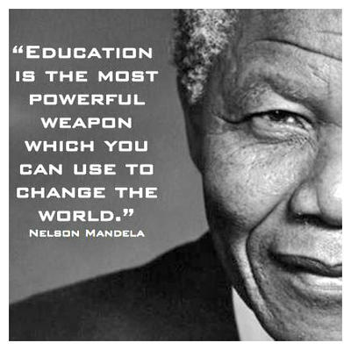
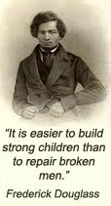
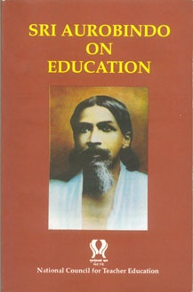
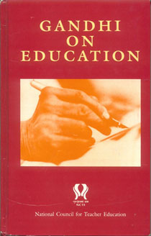

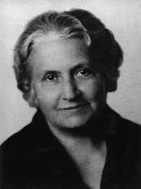
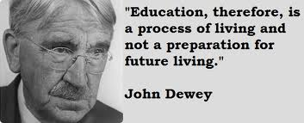

of course, of course…
“The true basis of education is the study of the human mind -- infant, adolescent and adult…”
Real education consists in drawing the best out of yourself. What better book can there be than the book of humanity?

Slide 6

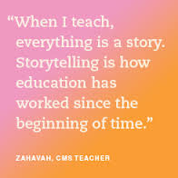
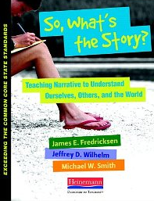
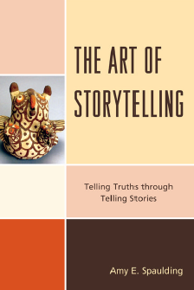
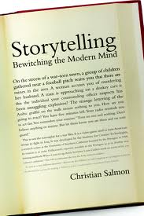
so, what’s the story?

Slide 7
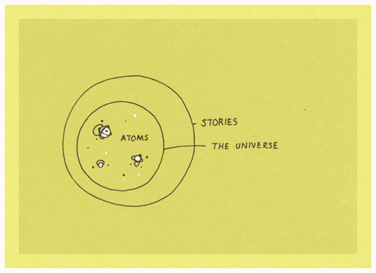
…the universe is made of stories, not of atoms!
– muriel rukeyser
psst… Is there a reversal here?

Slide 8
the power of stories of symbols…
1 + 1 = 1

Slide 9
the power of stories of contexts & connections
place value in numbers / counting
so the child thinks: we can continuously count from 1 to 10 using the fingers of our hands
finger binary
with only 10 fingers of our hands, we can count continuously from 0 -> 1023!

Slide 10
abstractions in education
symbols
connections
contexts
concrete ->> abstract (n:1)
abstract ->> concrete (1:n)
stories, stories and more stories…

Slide 11
brain: the very basics
It has many parts, of course it is great and all that – but, why should we talk about this and its capacity?
… because
  We have to use it ourselves (for our own benefit!)
  We need to use it to teach
  We need to make our students understand what we teach, with their own brains…

Slide 12
…let us focus on cerebrum!
… which is a part of our fore-brain.
This is the seat of our consciousness.
It is the center of mental activity.
It receives messages from the sense organs and enables us to observe our environment through them.
The information gained through the sense organs is stored in memory / cerebral cells (we all have the same number of them) – and are used when necessary; we commonly refer to it as the ‘memory power.’

Slide 13
storehouse of memories / learning
Working memory is the ability of the brain to maintain a temporary representation of information about the task that we are currently engaged in. (focus on the current work)
Episodic memory is the ability to remember the details of specific events. This sort of memory can last for a lifetime. (describing, explaining, reasoning…)
Instrumental learning is the ability for rewards and punishments to modify behavior. (postponement of gratification)
Semantic memory is the ability to learn facts and relationships. (connections, connections…)
Motor learning is the ability to refine patterns of body movement by practicing, or more generally by repetition. (meditative work)

Slide 14
the most important aspect of this cerebrum – apart from the memory is that it is the seat of…
Intelligence – all of us have the same amount – irrespective of what urban legends & ‘knowledgeable rumours’ say.
Emotions – all of us are capable emoting normally, with a few and rare genetically wired exceptions.
Reasoning power – we all have oodles of it!
Imagination – ah, this is where some of us lack depth – but we can learn to imagine!
Will power – and yeah, some of us may not be persistent cookies – but we can always train ourselves to enhance our will power.

Slide 15
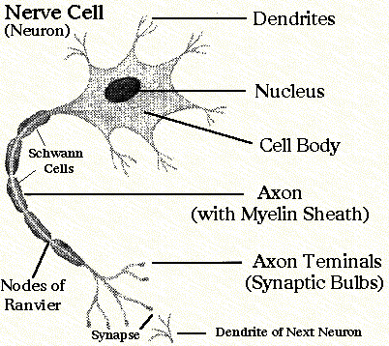
how do connections happen…
… an estimate puts the human brain at about 100 billion (10¹¹) neurons and 100 trillion (10¹⁴) synapses.
… another estimate puts the figure as approximately 30 billion neurons in the rest of the human body penetrating every tissue in every part!
… synaptic connections hold the key (of course, among others)
… through the exercise of willpower and imagination together – we AND our students can achieve what we can aspire for…

Slide 16

stories are the way…
into the hearts and minds of…
  not only children, but also…
  us!

Slide 17
montessori has ‘five great stories!’
…well, actually lessons! ☺
coming of the Universe and the Earth (the beginning)
coming of Life (time-line of life)
coming of Human Beings (evolution of humans)
communication in Signs (the history of writing)
the Story of Numbers (the history of math)
… and these are targeted at 1, 4 grade levels; these are some of the fantastic big picture ideas that capture the imagination of the children – YES, that is, catching ‘em young!
… and the children branch off in many directions from the spaces and fantastic paths that the stories open-up!

Slide 18

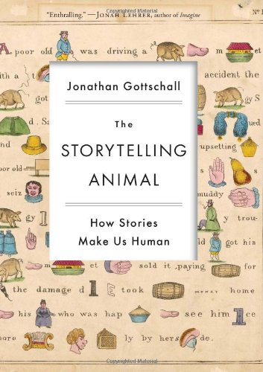
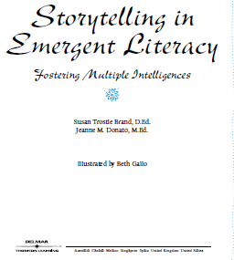
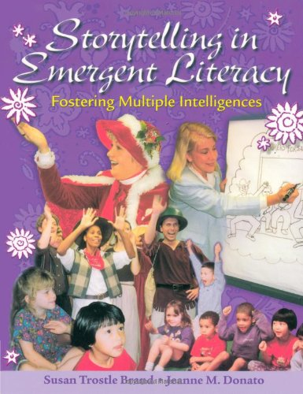

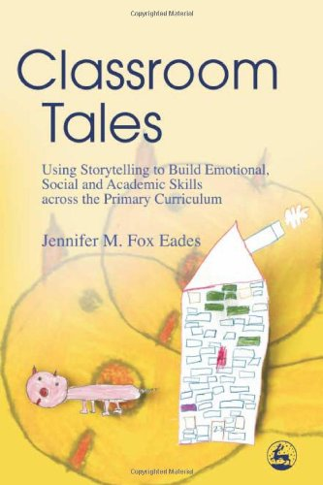

Slide 19
stages of human development (in one lifetime, that is!)
progression – o’ progress, unceasing progress!
physical, psycho-behavioral, spiritual paths
the idea of ashramas (=stages in life)
  the child ->> brahmacharyaa, grahasthaa, vaanap-prasthaa, sa-nyaasaa ->> moving on…
developmental stages of us humans…
… let us slice it, in different ways

Slide 20
miracles in the womb…
post conception, the mother’s heart sends a signal to the mass of cells that is in the womb and a few of these cells start pulsating in rhythm to that of the mother’s heart – this group develops into the heart of the foetus.
eventually there is some kind of magnetism (or may be not) that sets in due to this pulsation and the cells around this heart, get a signal to go become a this or that in the body of the child in the womb. The brain also is formed as some cells receive such an instruction from the incipient heart of the foetus.

Slide 21
miracles in the womb…
… from this incipient heart, the neural tube forms; at one end of this tube, the brain gets formed and its growth & strength are controlled and determined by the cells of the heart.
First trimester: the reptilian part of the brain forms; this will control the sensory-motor skills, and houses the instincts for basic survival.
Second trimester: the mammalian part of the brain forms; this contains the parts dealing with emotions, cognition and mapping.
Third trimester: the neo-cortex part of the brain develops; here, the capacities for creativity, intellect reside.

Slide 22
miracles in the womb…
and… Neoteny follows Phylogeny – as Desmond Morris eloquently puts it, and am not even talking about this wonder.
it is amazing that after the birth of the child, these three parts / segments of the brain unravel in the same order – but, over the period of the next 20 odd years, instead of 9 months – and are to be attended to at the appropriate level.
nurture is the keyword throughout these stages – and if the child receives the appropriate & needed inputs at a given level of development, there is no way at all that a given child’s incredible capacities could not be realized…

Slide 23
piaget, steiner, montessori
… have all mapped the requirements of such developments in the brain and the persona of the child to the appropriate age groups – and have worked out in minute detail, the material, environmental requirements (and much else) that the adults can provide to help the child.
the Montessoriese for this idea would be ‘sensitive’ periods, ‘explosion’ in to some developmental aspect of the child etc, etc. The languages and jargon of these folks are different, but there is a fundamental common thread of thoughts in all of them.

Slide 24
jean piaget
… according to Piaget, the following are mappable to the three-segmental growth of the brain:
Reptilian: From birth till the emergence of the first ‘milk’ teeth.
Mammalian: From the previous stage to when the milk teeth are lost and replaced by ‘permanent’ teeth – circa 8-9 years of age.
Neo-cortex / prefrontal lobes: Intellectual growth begins after the previous stage and the prefrontal lobes keep developing till about 21 years!
  During the mid part of this stage – circa 11-15, the child begins to develop the capacity to work with and operate upon what they have previously learned.

Slide 25
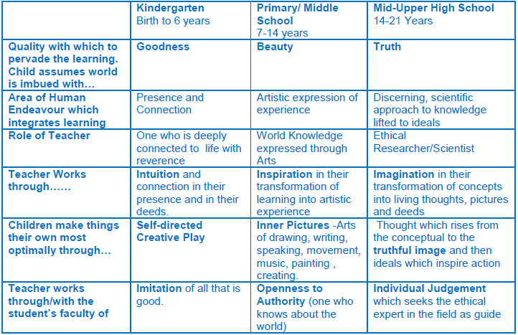
rudolf steiner

Slide 26
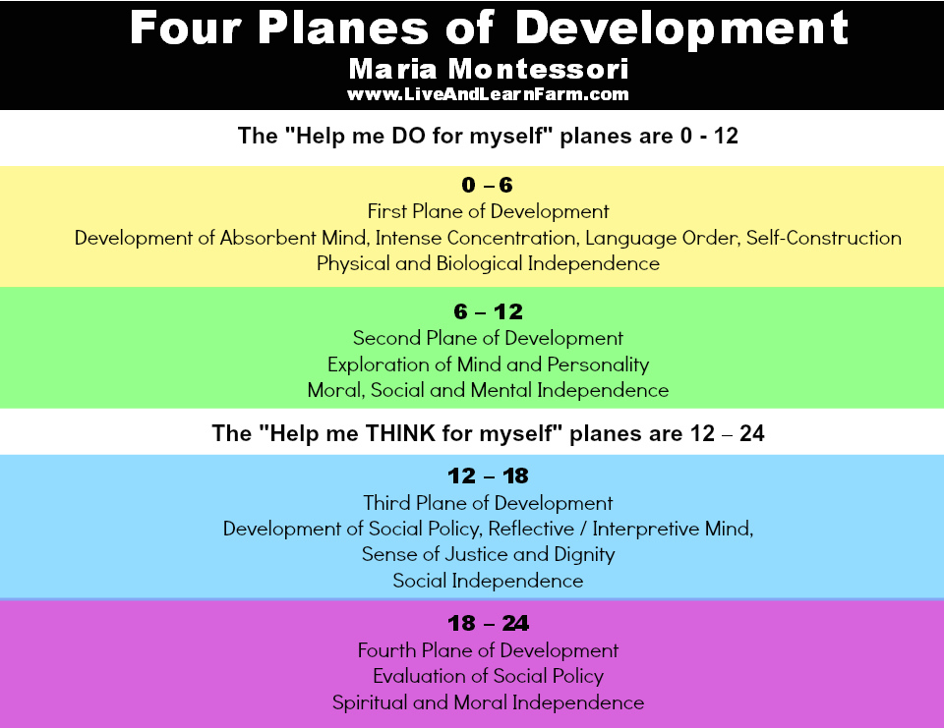
maria montessori

Slide 27
maria montessori
first plane of development (0 – 6): children are sensorial explorers; 0-3 - unconscious absorbent minds. 3-6 - conscious absorbent minds.
second plane (6 – 12): they are reasoning explorers
third plane (12 – 18): they become human explorers… focusing on figuring out society and where they fit in.

Slide 28
some interesting montessori ideas
independence: sense of joy and achievement; self reliance
sensorial education: forms the basis of creative work; development of the intellect
concentration/focus: when something that answers the inner needs meet with the inner urge, spontaneous interest is kindled. When this interest finds suitable conditions to work, spontaneous repetition is the result, when the spontaneous repetition is done with interest, the natural interest is concentration.
normalization: when a child is normalized it has a fantastic combination of self-discipline, concentration, independence and a love for purposeful activity.
freedom & discipline: freedom of choice and freedom of time lead to inner discipline and peace.
imagination: imagination based on scientific facts lead to creativity; fantasy causes intellectual confusions
concrete experiences: difficult concepts can be presented to sub 5 year olds by providing concrete experiences throuth hands-on approach.
adult: the teacher in the environment is an observer and is passive.
environment: the physical setting of the classroom with all the materials and relevant work furniture.

Slide 29
gandhi’s nai taleem
7 -14 years
educating the child in expanding circles
through a productive craft
blue print for learning from labour and for labour
primarily an apprenticeship model
anything not involved in the craft or the life of the child – not considered

Slide 30
sri aurobindo: integral education three basic tenets
  nothing can be taught.
    what the individual could do, what the raison d'etre is, only he/she can figure out
    but everything can be learnt, if the mind is prepared
  the mind has to be consulted in its own growth.
    finding out one’s calling in life
    inward focus the only way to go up the path.
  near to far
    from the concrete to the abstract – the way to metacognition
    from the known towards the unknown
    to evolve!

Slide 31
the mother five axes of education
physical: governed by method, order, discipline, process
mental:
  power of concentration, the capacity of attention.
  capacities of expansion, widening, complexity and richness.
  organisation of one’s ideas around a central idea, a higher ideal or a supremely luminous idea that will serve as a guide in life.
  thought-control, rejection of undesirable thoughts, to become able to think only what one wants and when one wants.
  development of mental silence, perfect calm and a more and more total receptivity to inspirations coming from the higher regions of the being.
vital: holds power, energy, enthusiasm, effective dynamism
psychic: immortal life, endless time, limitless space, ever-progressive change, unbroken continuity in the universe of forms.
spiritual: to live the infinite and the eternal, to be projected beyond all creation, beyond time and space

Slide 32
so,
what are we up to?
is there any scope for improvement?
  In ourselves
  In our environments
  In our delivery methods to impart education
  In our lives
let us think…

Slide 33

The lyf so short, the craft so long to lerne.
-- Chaucer Parliament of Fowls 1.1 c 1380
-- Hippocrates (Aphorisms 1.1 )
vita brevis, ars longa
அருவினை யென்ப உளவோ கருவியான்
காலம் அறிந்து செயின்.
-- திருவள்ளுவர் (பொருட்பால்/அரசியல்/காலம் அறிதல்/483)
ஞாலம் கருதினுங் கைகூடுங் காலம்
கருதி இடத்தாற் செயின்.
-- திருவள்ளுவர் (பொருட்பால்/அரசியல்/காலம் அறிதல்/484)
जैसे नदी बह जाती है और लौटकर नहीं आती, उसी प्रकार रात और दिन मनुष्य की आयु लेकर चले जाते हैं, फिर नहीं आते।
-– महाभारत
so…
what can one do?

Slide 34
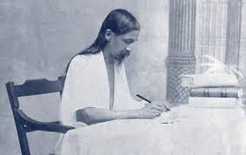
Everyone has in him something divine, something his own, a chance of perfection and strength in however small a sphere which God offers him to take or refuse. The task is to find it, develop it & use it. The chief aim of education should be to help the growing soul to draw out that in itself which is best and make it perfect for a noble use.
-- Sri Aurobindo

